Slide 1
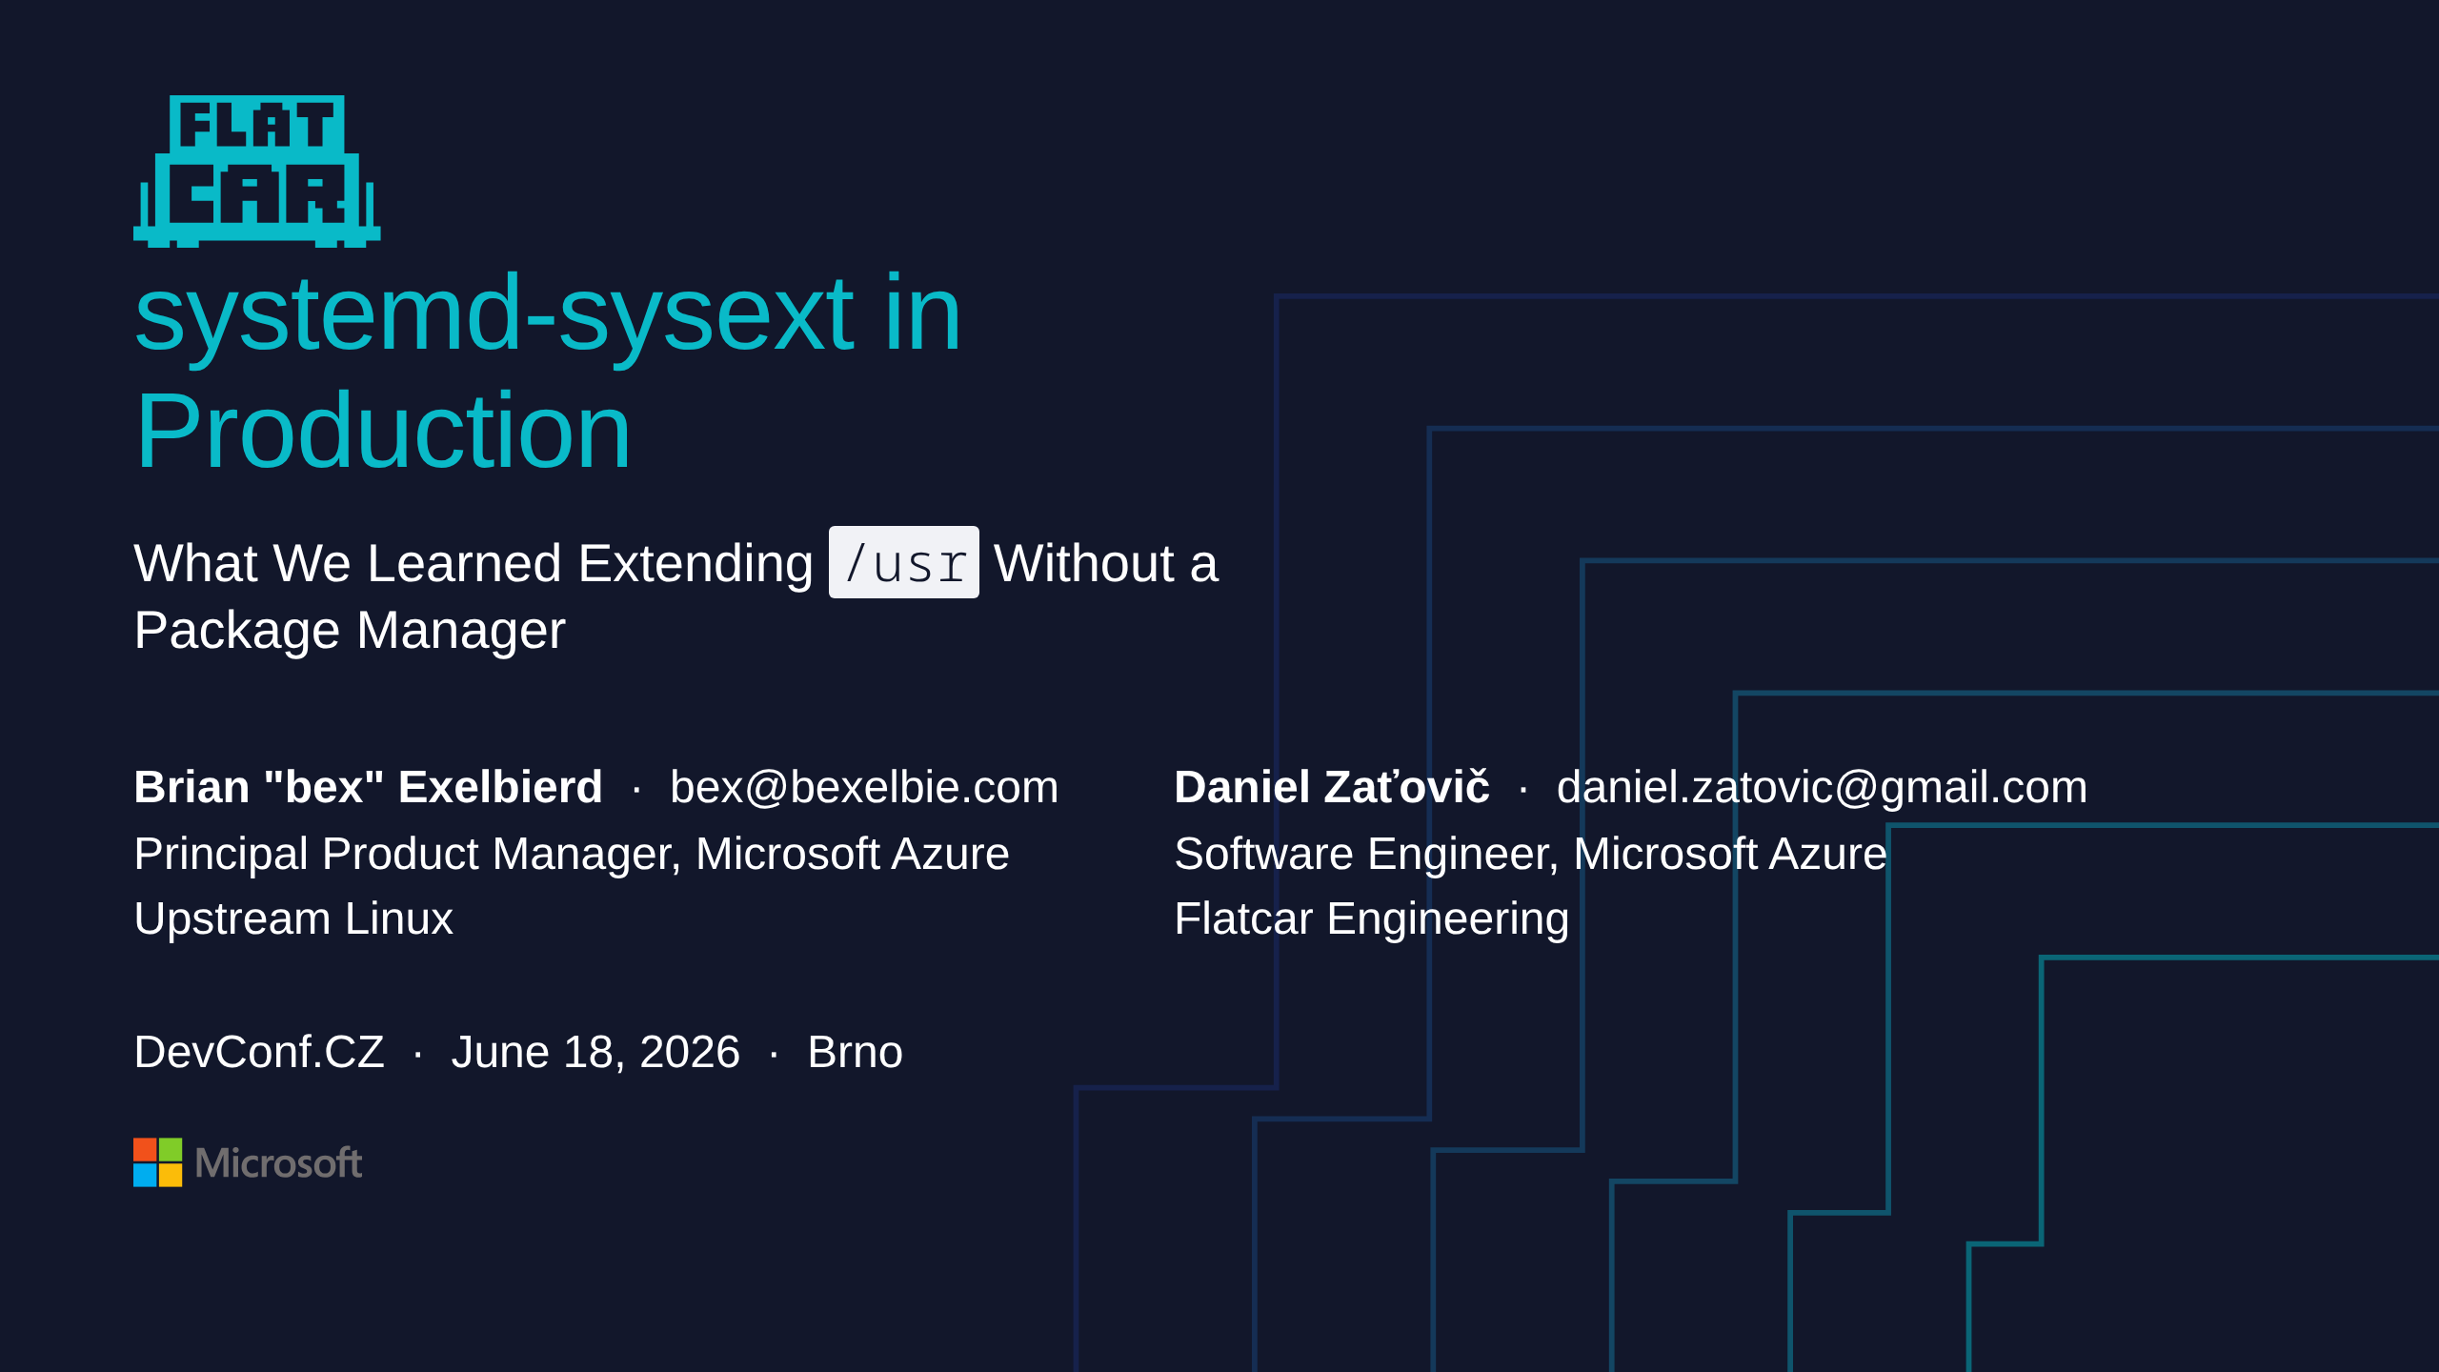
Notes:
- intro

Slide 2

Notes:
bex
- I want to start with a frustration.
- Every distro, every immutable OS, every cloud-native platform — they all eventually trip over the same problem: "how do I get this binary onto that host in a way I can update and roll back without breaking everything else."
- This is the oldest problem in our industry and we keep inventing new answers to it.
- That's not a complaint. It's a setup.

Slide 3
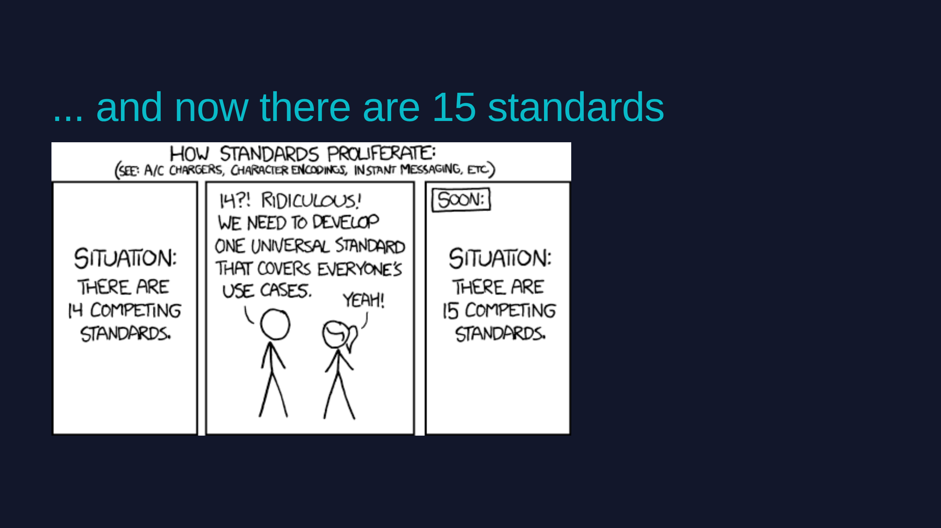
Notes:
bex
- Having lots of standards isn't actually bad. Standards make some problems easier, often at the expense of making others harder. You have to decide which problems matter to you.
- sysext is one of those standards. We are not going to pretend it makes the problem go away.
- What we ARE going to tell you is when it's the right one — and what we've learned shipping it in production for two and a half years.

Slide 4
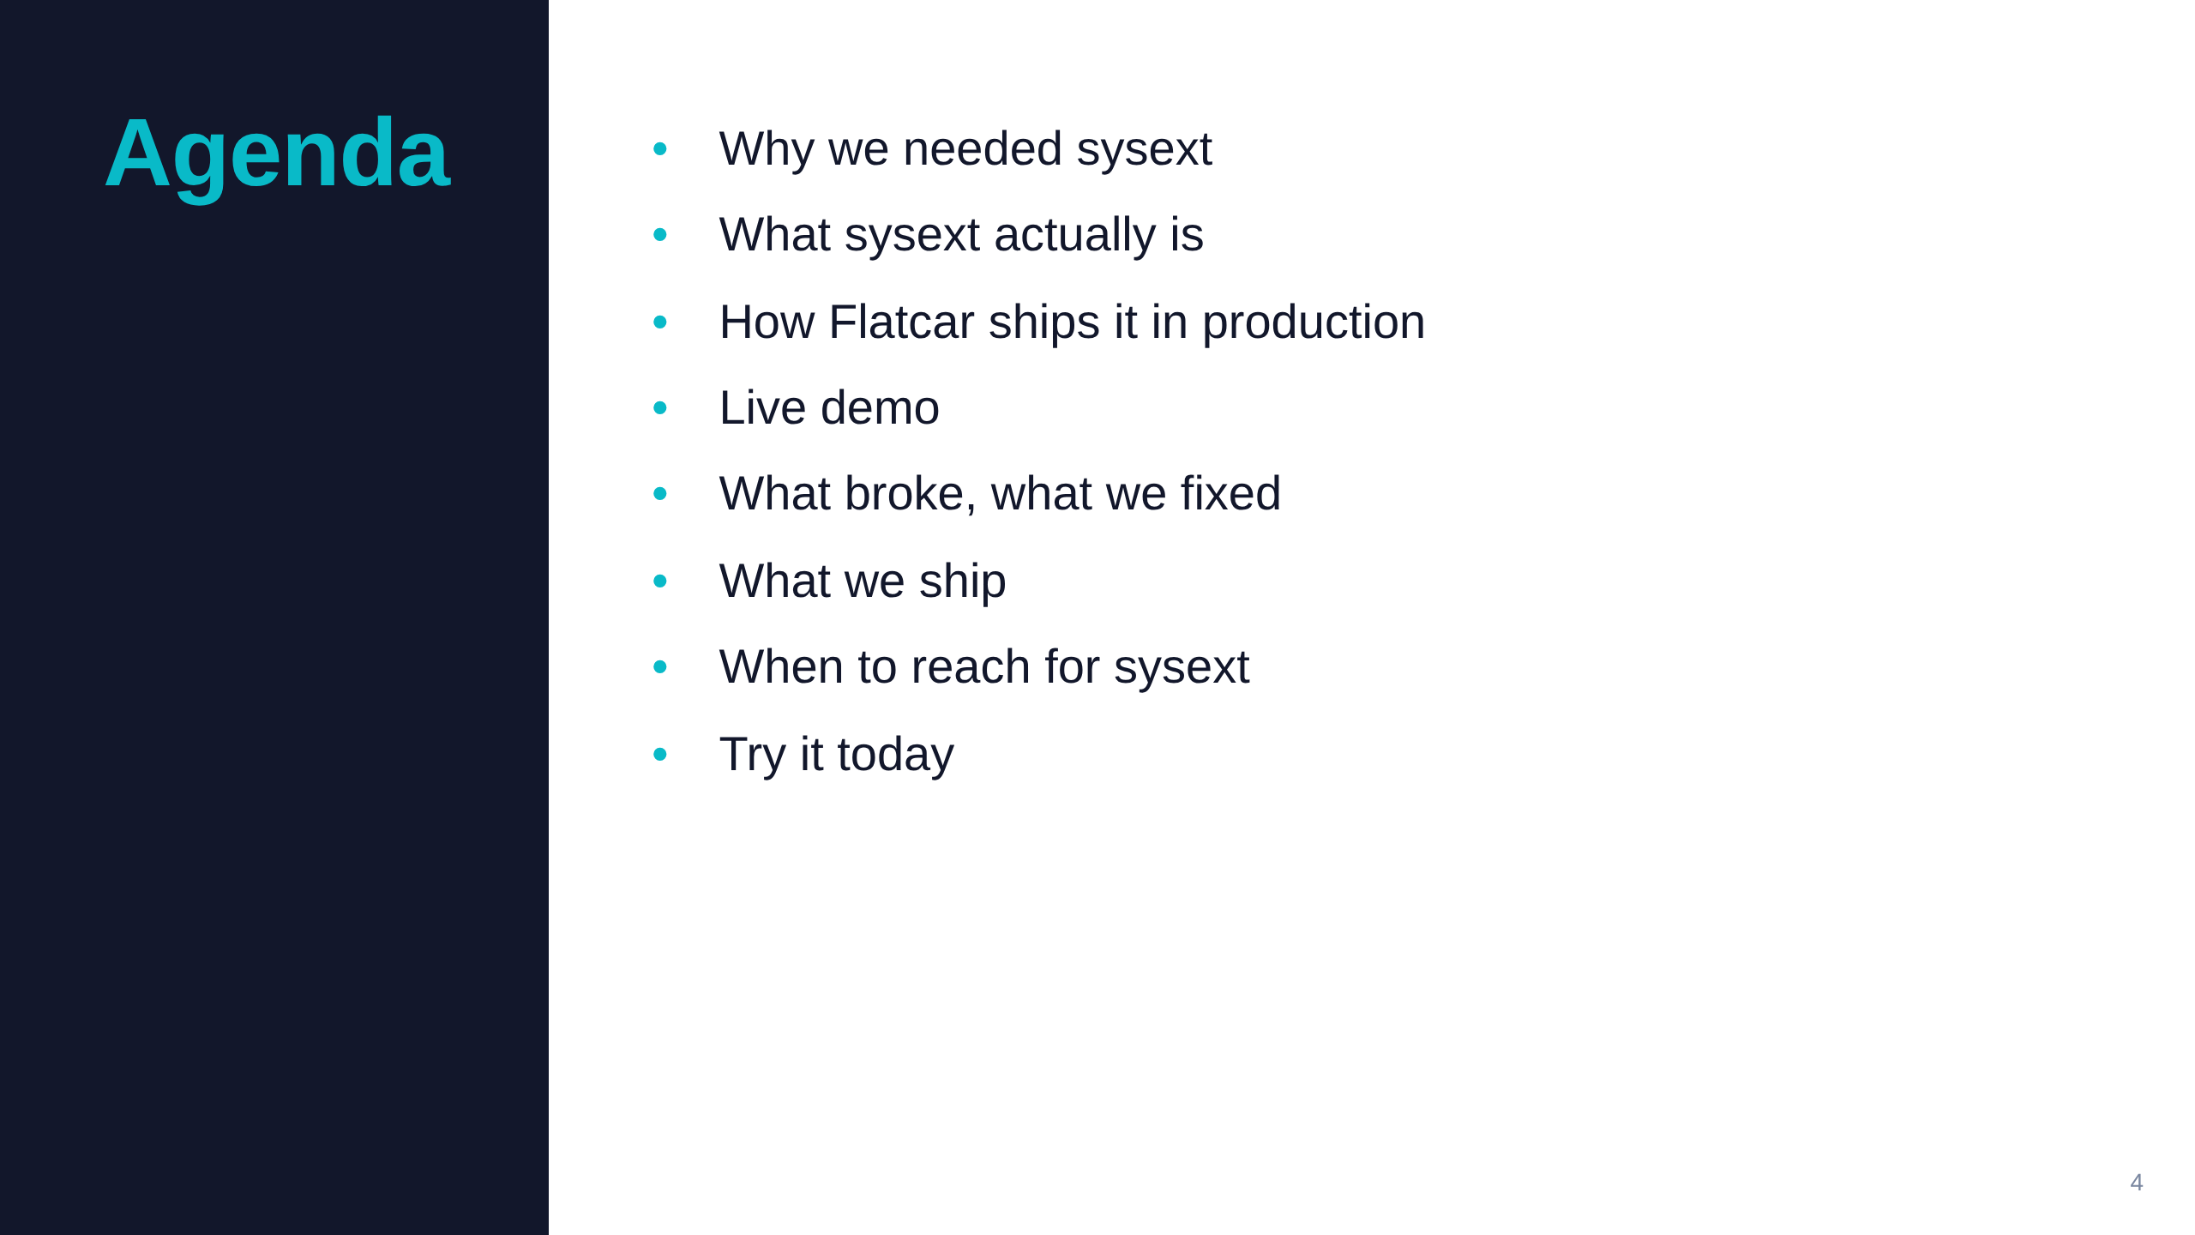
Notes:
bex
This is what we're going to talk about today

Slide 5
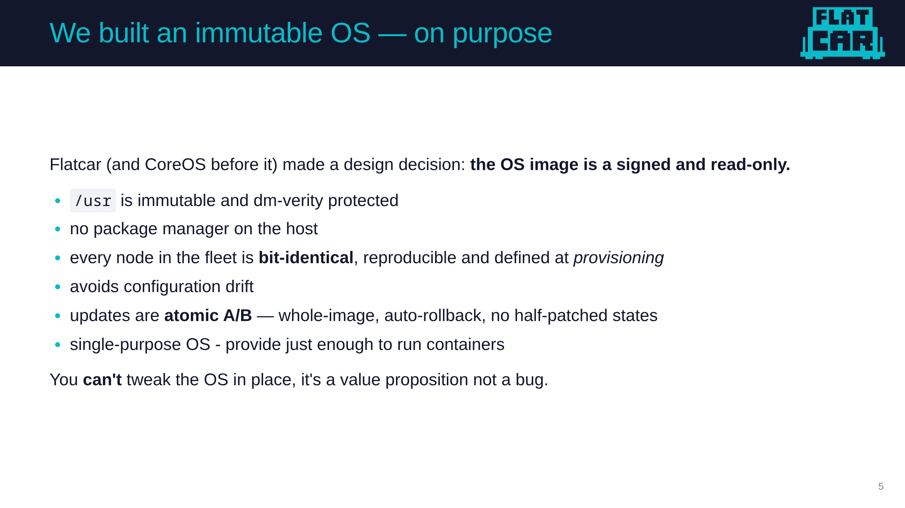
Notes:
Daniel
- Start with the design.
- Treat the OS like firmware/adapter to run cintainers (flatcar carrying containers).
- Read-only /usr, verity, atomic updates, no rpm/dpkg on the host.
- This is great for security and for running a fleet — every machine is the same machine.

Slide 6
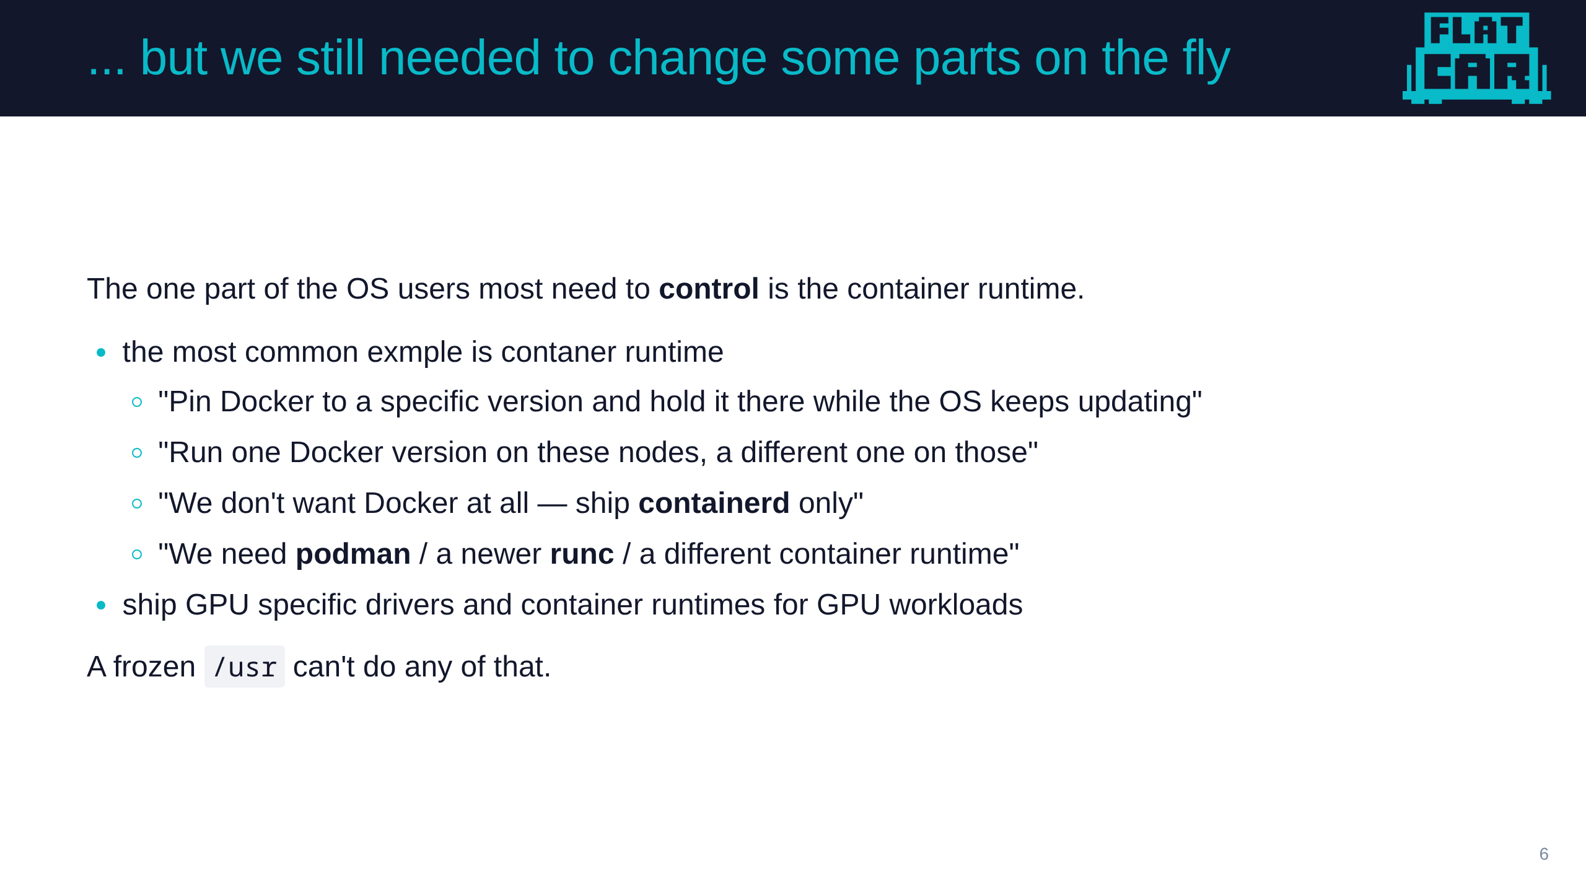
Notes:
Daniel
- But it causes a problem: the thing people most want to change is sitting inside the part we froze.
- various requirements regarding container runtime
- All of that is userspace that lives in /usr — exactly where we don't allow changes.
- So we needed a way to make a few specific, OS-adjacent components swappable without giving up immutability everywhere else.

Slide 7
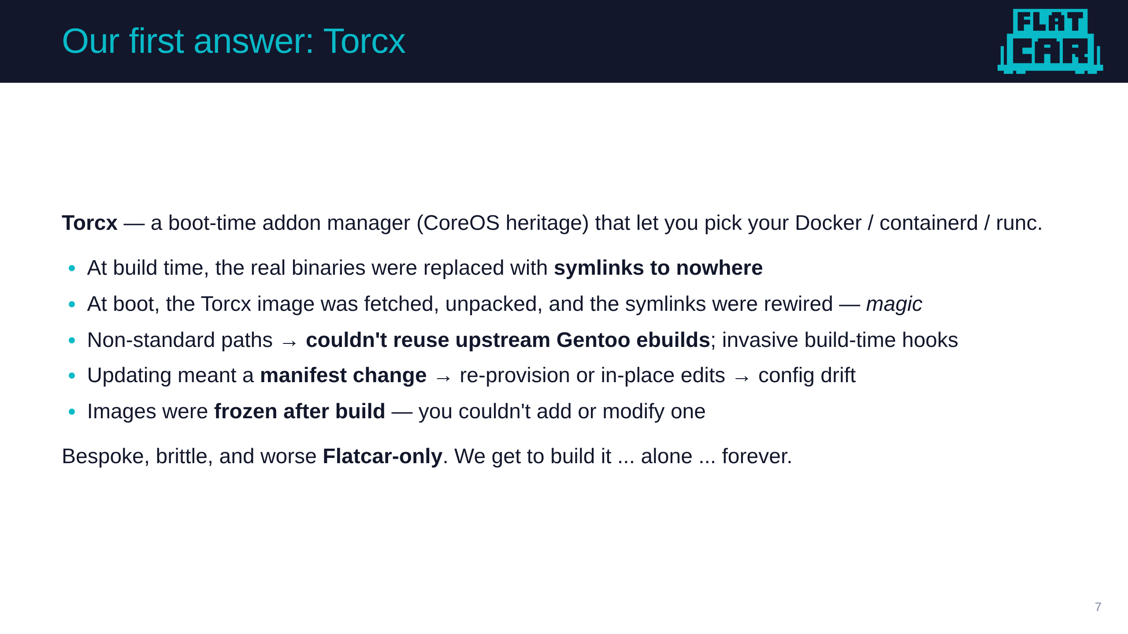
Notes:
Daniel
- Torcx did the job for years, and it's our origin story for sysext.
- At build we baked symlinks-to-nowhere; at first boot Torcx downloaded an image, extracted it, and pointed the symlinks at the right place. That's the "magic" we wanted to kill.
- It was custom tooling end to end — special packaging, non-standard paths so we couldn't reuse upstream ebuilds, a manifest you had to edit, images you couldn't change after build.
- Hard to maintain, hard to version, hard to update, and nobody else in the industry shared the burden. That last part matters for the next slide.
- Removed almost 3 years ago (in Alpha 3794.0.0, November 2023).

Slide 8
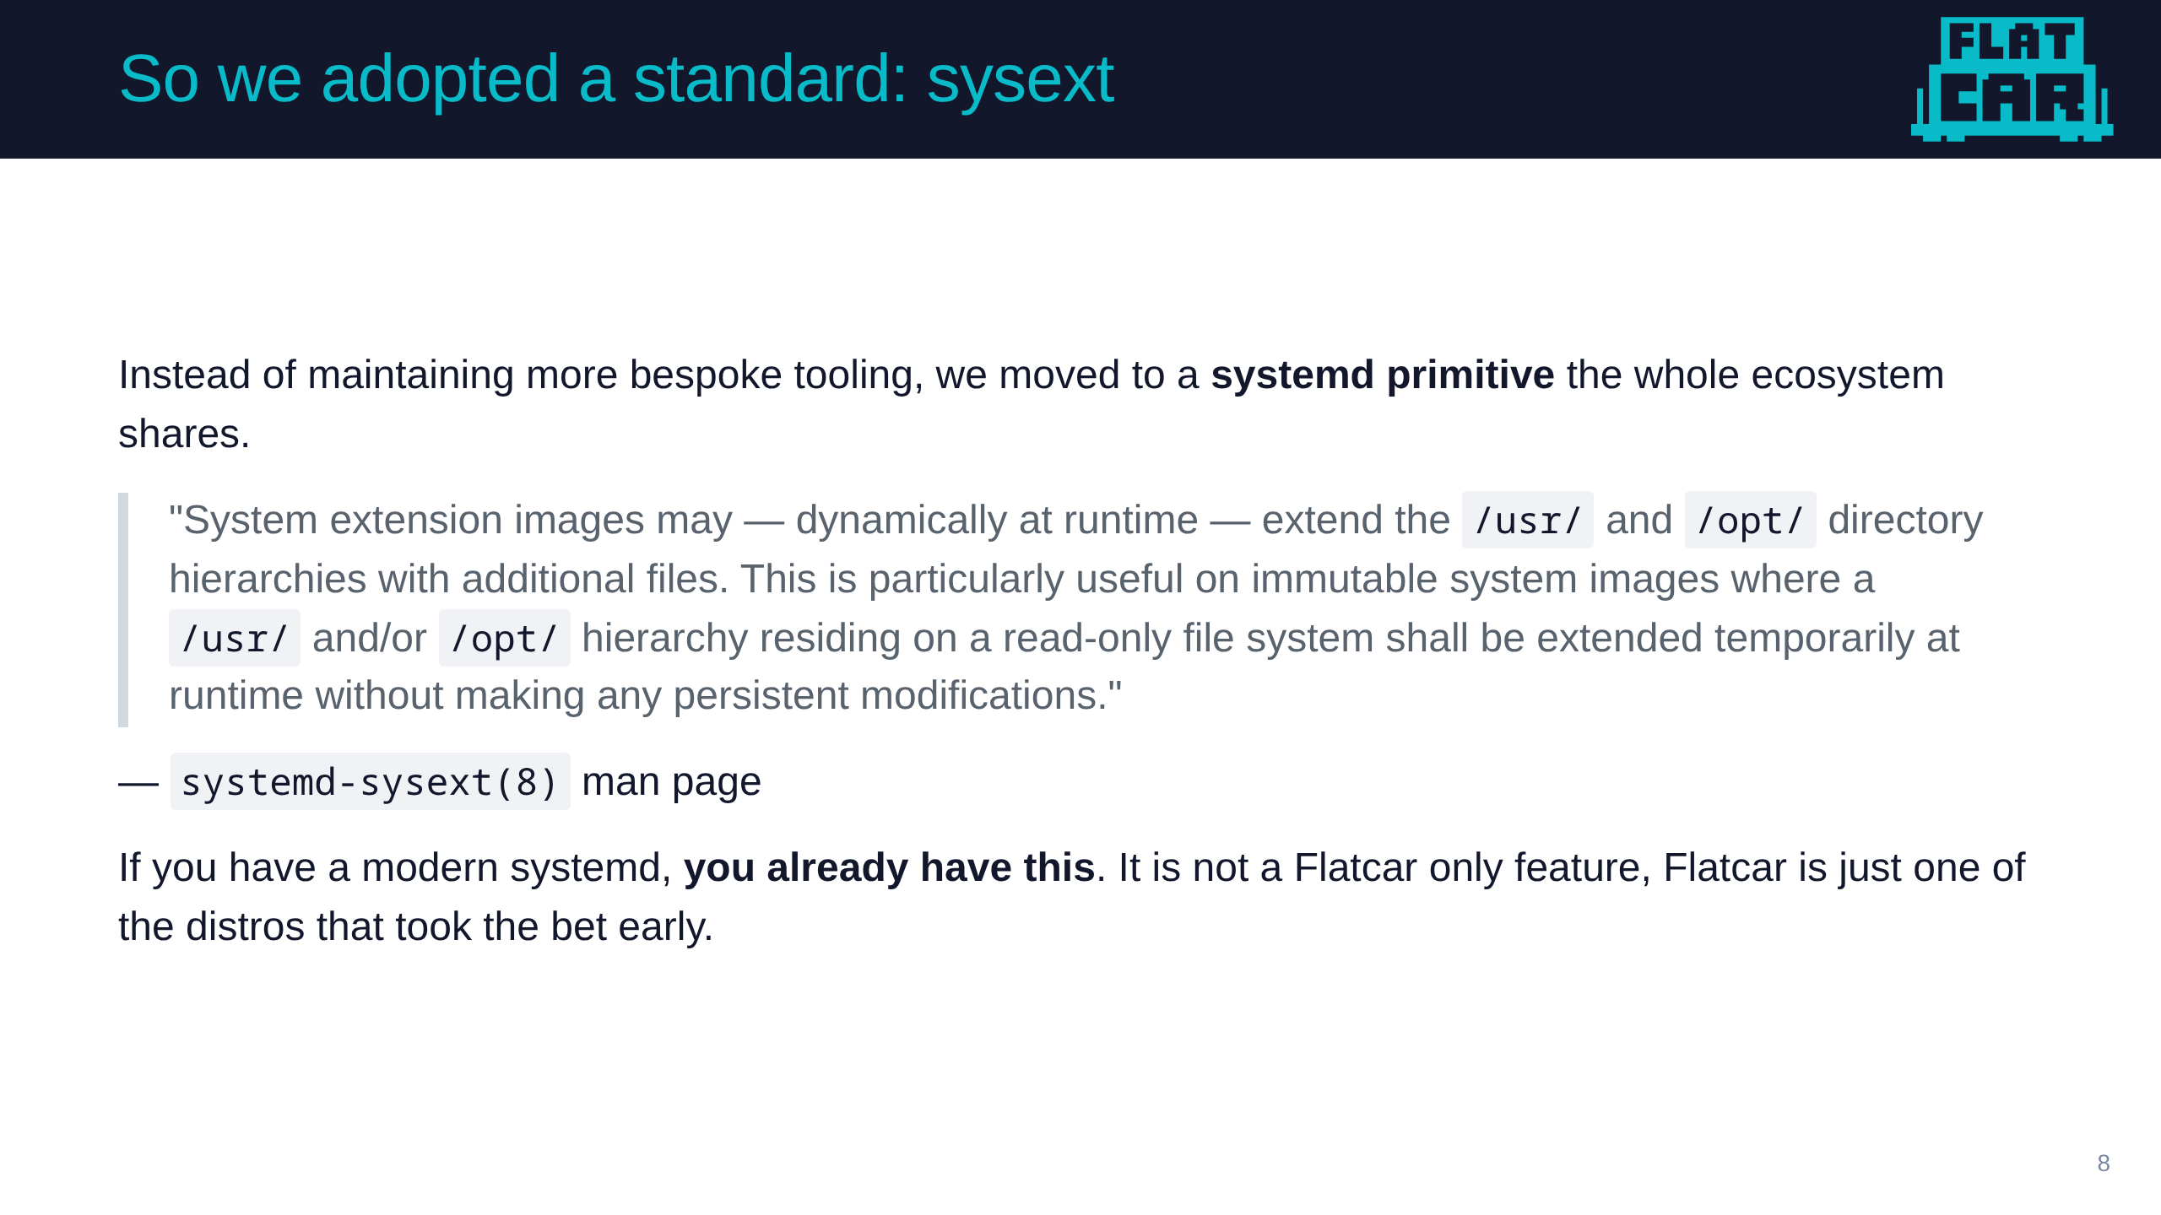
Notes:
Daniel
- as time progress, more distros with the immutable pattern started to show up and hitting the same problem
- UAPI standard and systemd-sysext were created
- rather than build Torcx 2.0, we adopted systemd-sysext — a cross-distro standard, not a Flatcar invention.
- The win over Torcx: it's a standard. The spec exists, the tooling exists, other distros support it — we stopped carrying the whole maintenance burden alone. Very few people have pushed it past "hello world." We have.
- similar concept exists for `/etc` called concept, we'll get to it later

Slide 9
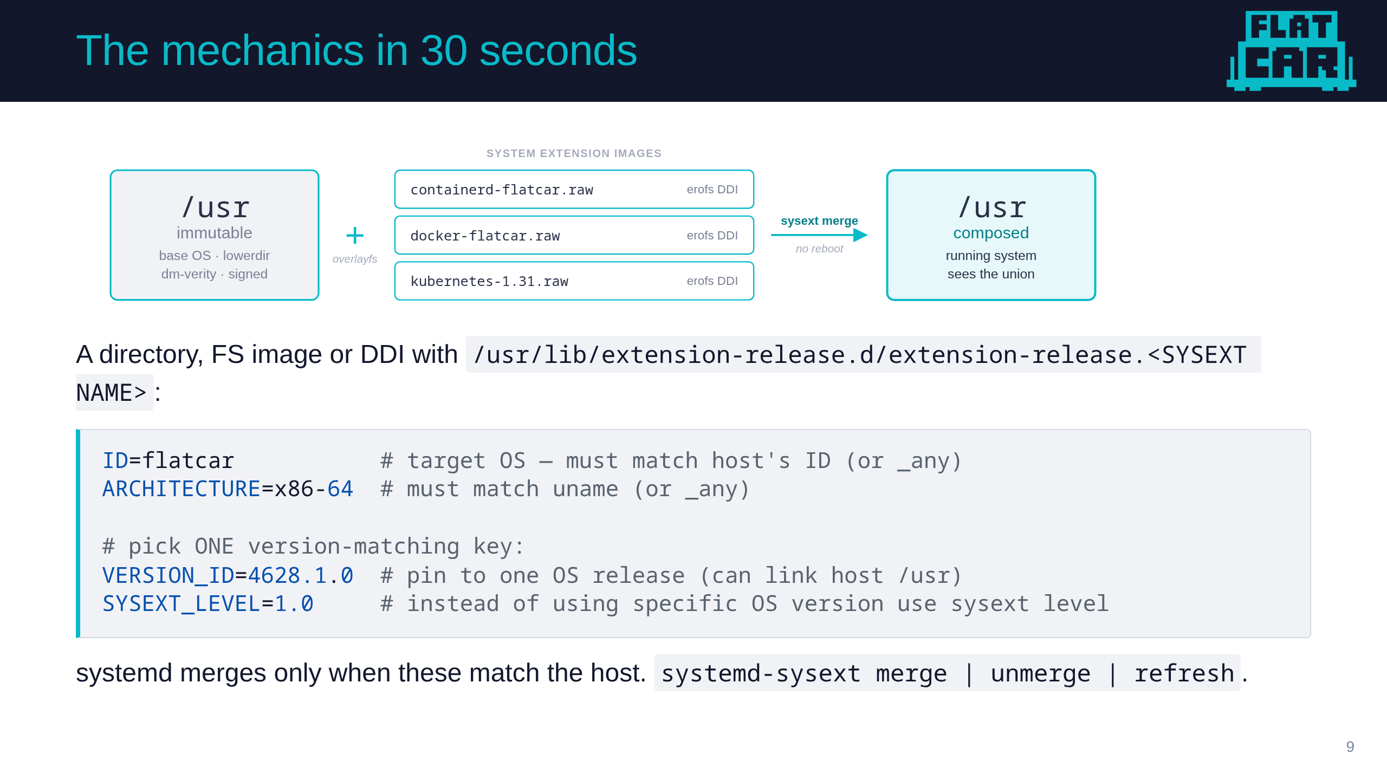
Notes:
Daniel
- A sysext is a directory, FS image or DDI — typically an erofs or squashfs filesystem or DDI image with dm-verity.
- The image's `/usr` tree is overlaid onto the host /usr via overlayfs. The base is the lowerdir, the sysext is added on top.
- merge composes the layers. unmerge tears them down. refresh re-evaluates after you add or remove an image. No reboot.
- There is a contract that defines what sysexts the system will allow - there are two basic concepts

Slide 10
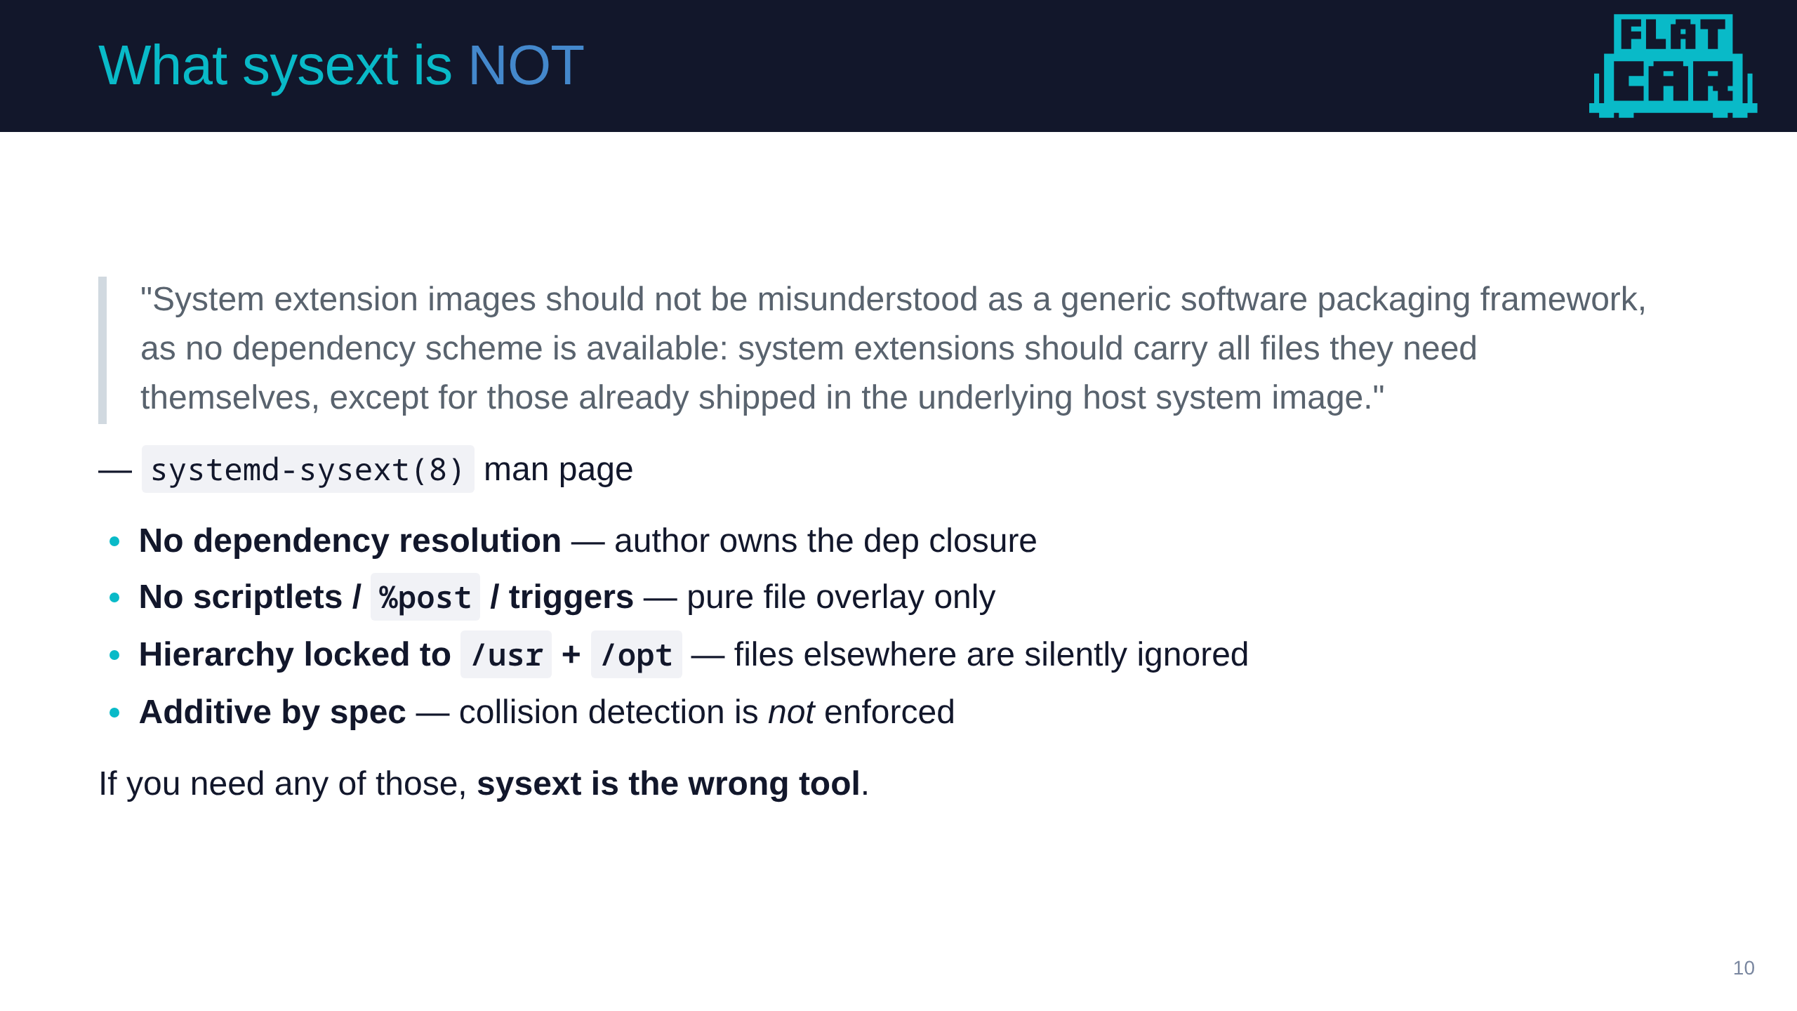
Notes:
bex
- It is important to understand - this isn't another package manager
- it does almost nothing a package manager does except the "deliver bits" part.
- None of the things a package manager provides are provided here
- depdency resolution, scriplets, etc.
- if you need these things you don't need sysext
- or learn not to need those things

Slide 11
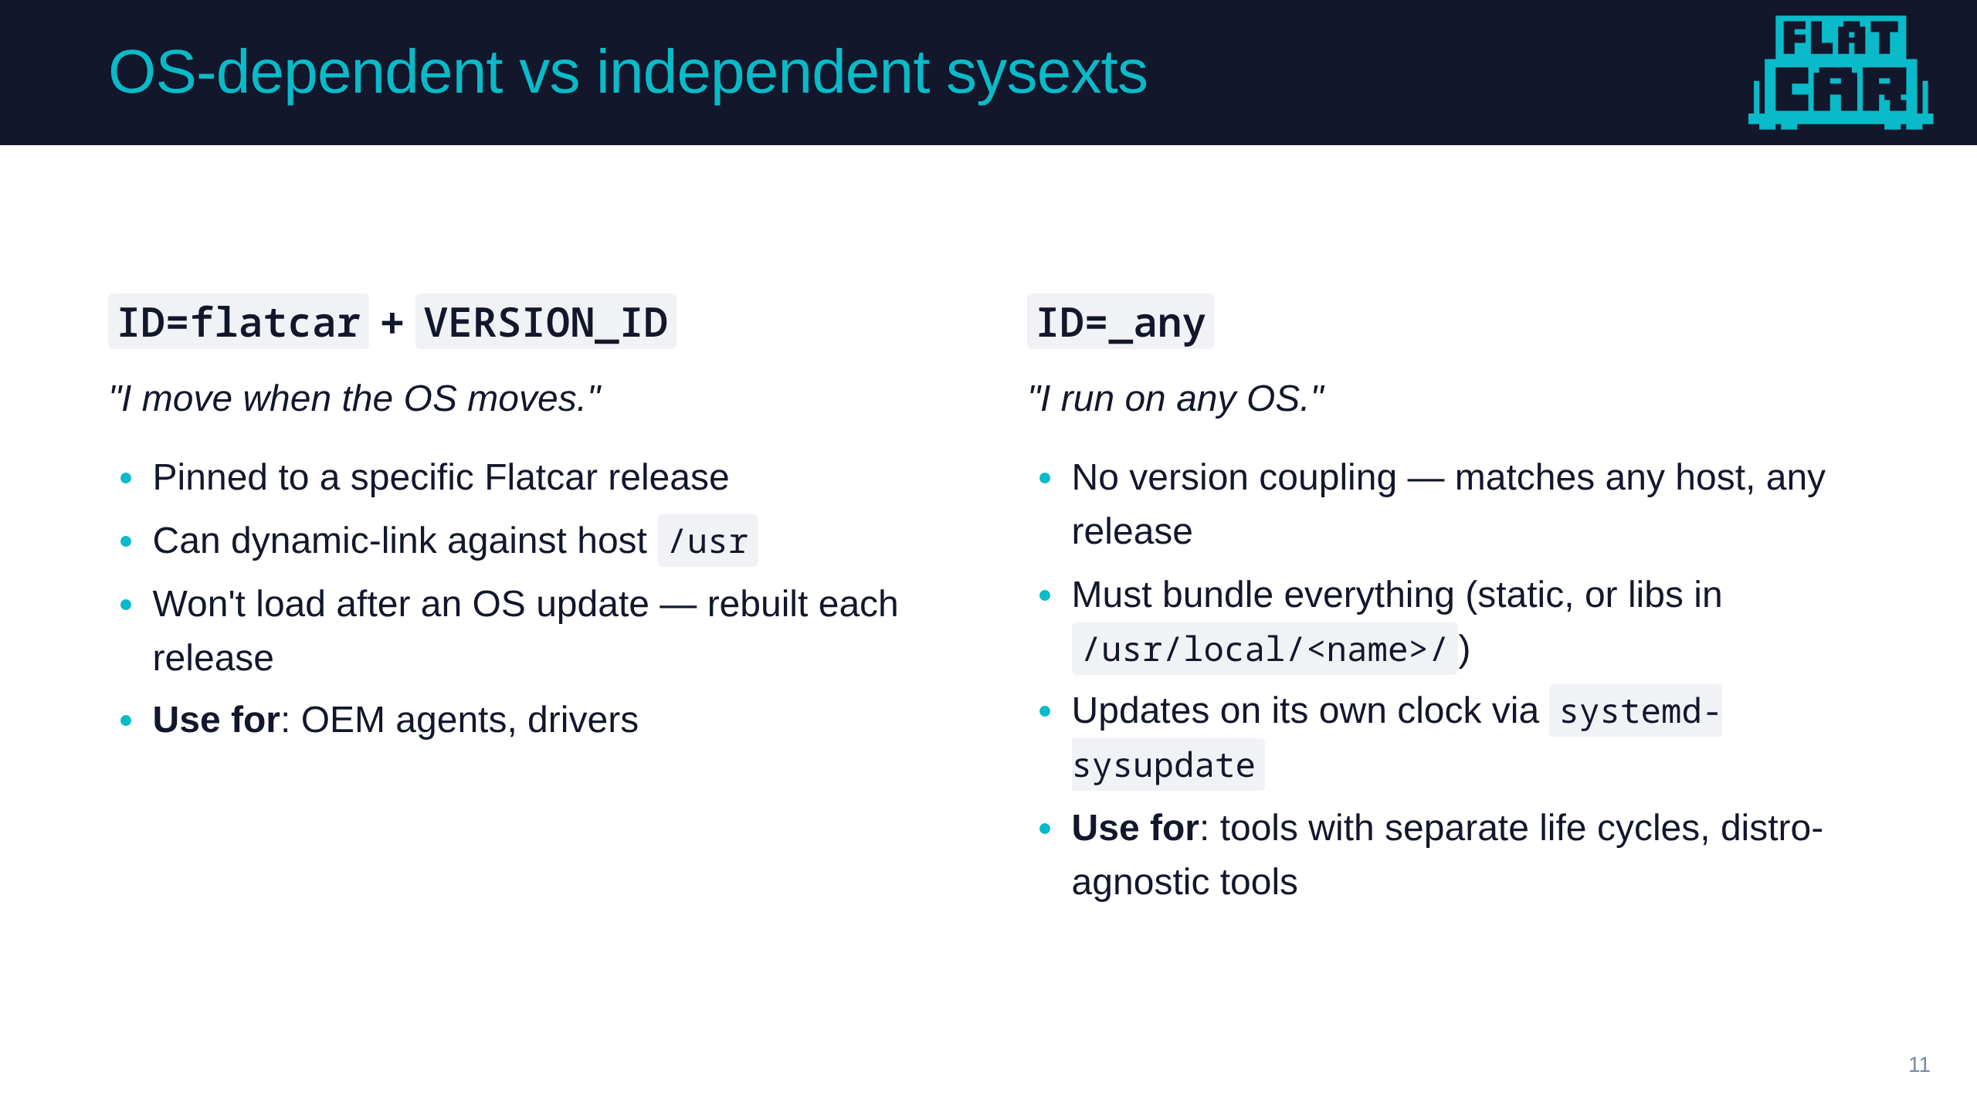
Notes:
bex
- you wind up with 2 kinds of sysexts, OS Dependent and OS Independent
- Depdendent means it relies on specific components of the base OS being in specific places at specific versions
- Independent means it brings all of its dependencies with it
- The core question you have to ask is, should this lifecycle with the OS or should it be independent of the OS

Slide 12
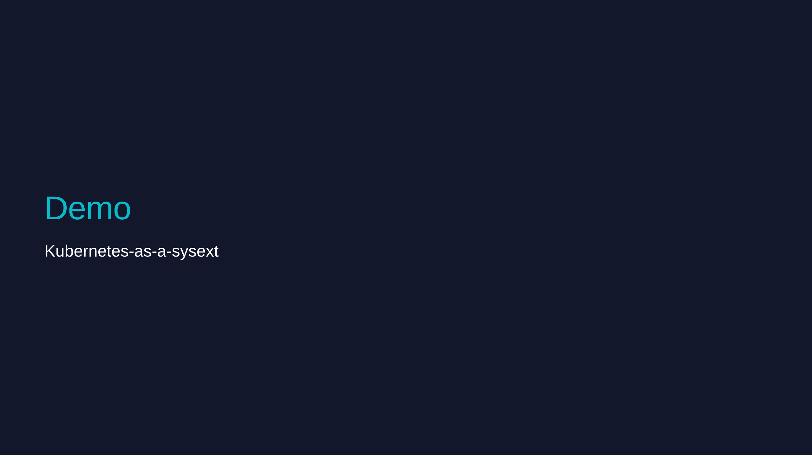
Notes:
Daniel
- 1. In Headlamp cordon and drain
- 2. On an existing Flatcar node, show kubelet version we have
- 2a - show loaded sysexts - see docker
- 2b - aside on docker then remove it
- 3. Show the raw image for the sysext
- 4. Show the check for new command (network hit)
- 5. Copy in staged update and merge
- 6. Restart kubelet and show kubelet version
- 7. In Headlamp scale the workload and get a new pod on the system - show the update applied

Slide 13
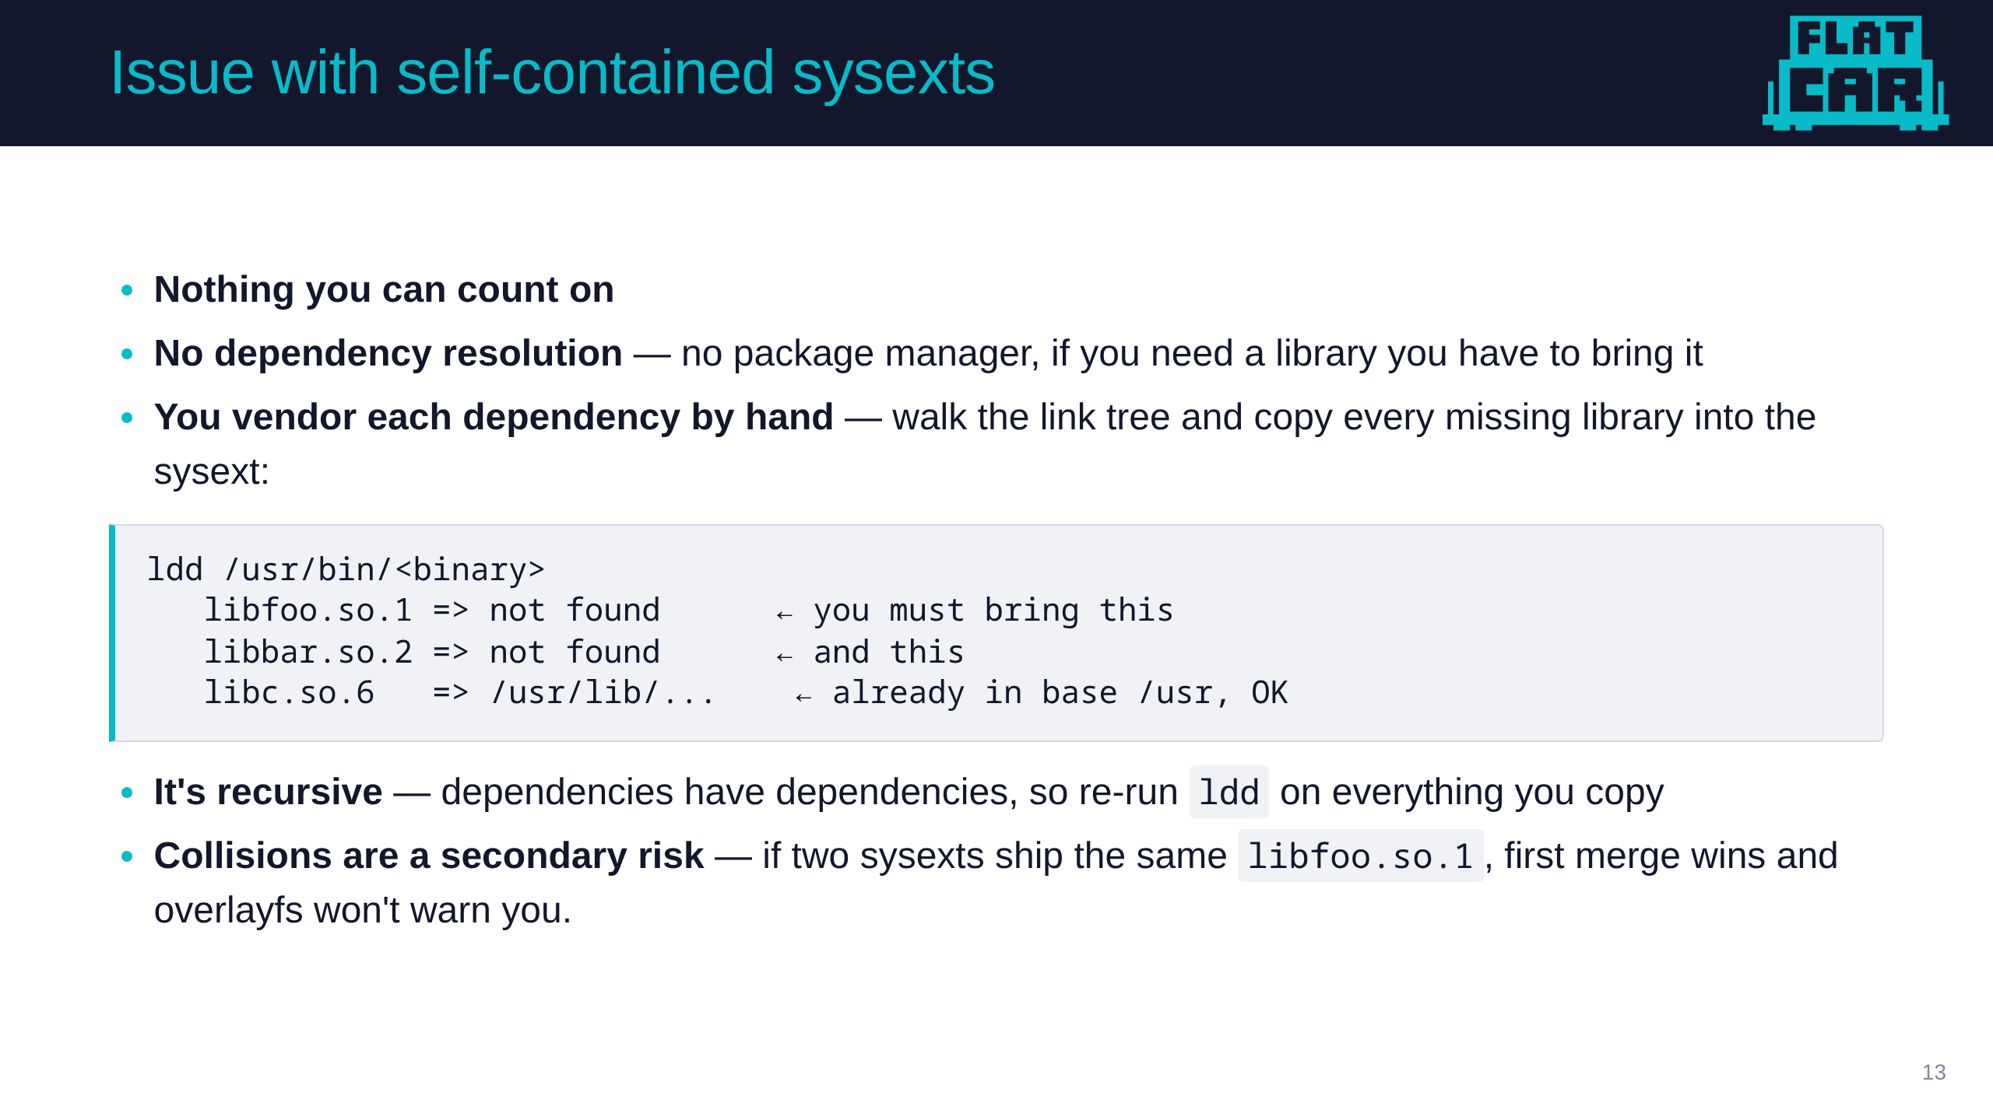
Notes:
Daniel
- The headline problem is NOT version collisions — those can happen but are rare. The real, everyday pain is that there's no dependency resolution at all.
- On an immutable OS there's no package manager on the host. If your binary needs libfoo and it's not in the base /usr, nothing will provide it. You have to vendor it into the sysext yourself.
- And it's recursive — you ldd the binary, copy the missing libraries, then ldd those libraries, because dependencies have dependencies. That hand-walking is the tedious part.
- The collision case (two sysexts shipping the same so, first merge wins, overlayfs won't detect it) is real but secondary — mention it, don't lead with it.
- There is no Requires:/Conflicts: in sysext. That's the deliberate trade for the simpler model — and it's exactly what the next slide's tooling (Flix/Flatwrap) automates.

Slide 14
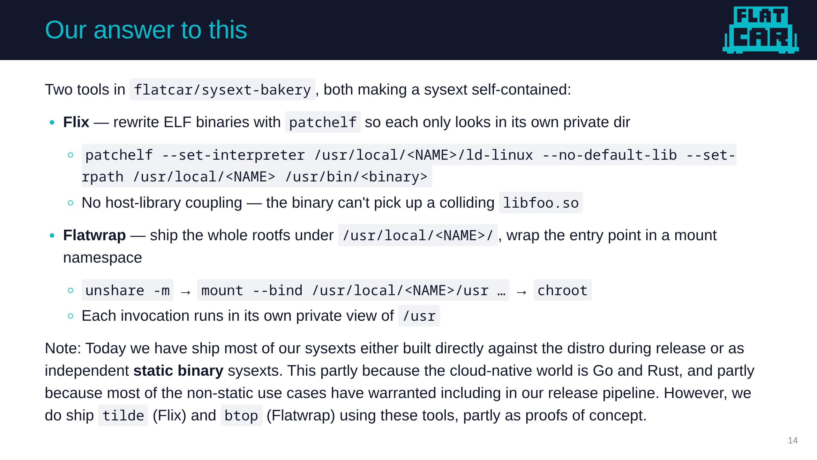
Notes:
Daniel
- Flix uses patchelf to rewrite RPATHs so binaries only look in their private directory. The bakery's tilde extension uses this.
- Flatwrap uses mount namespaces to give each binary its own view of /usr. The bakery's btop extension uses this.
- Both work. Both are elegant. Both are barely used.
- Why? Because cloud-native software is mostly Go and Rust. Kubernetes, containerd, runc, k3s, rke2, nerdctl — all statically linked. The dynamic-linking problem is mostly a non-problem if your target is the CNCF universe.
- The honest takeaway: we built two solutions, and we recommend the third option (static binaries). We have the tools when you need them. You usually don't.

Slide 15
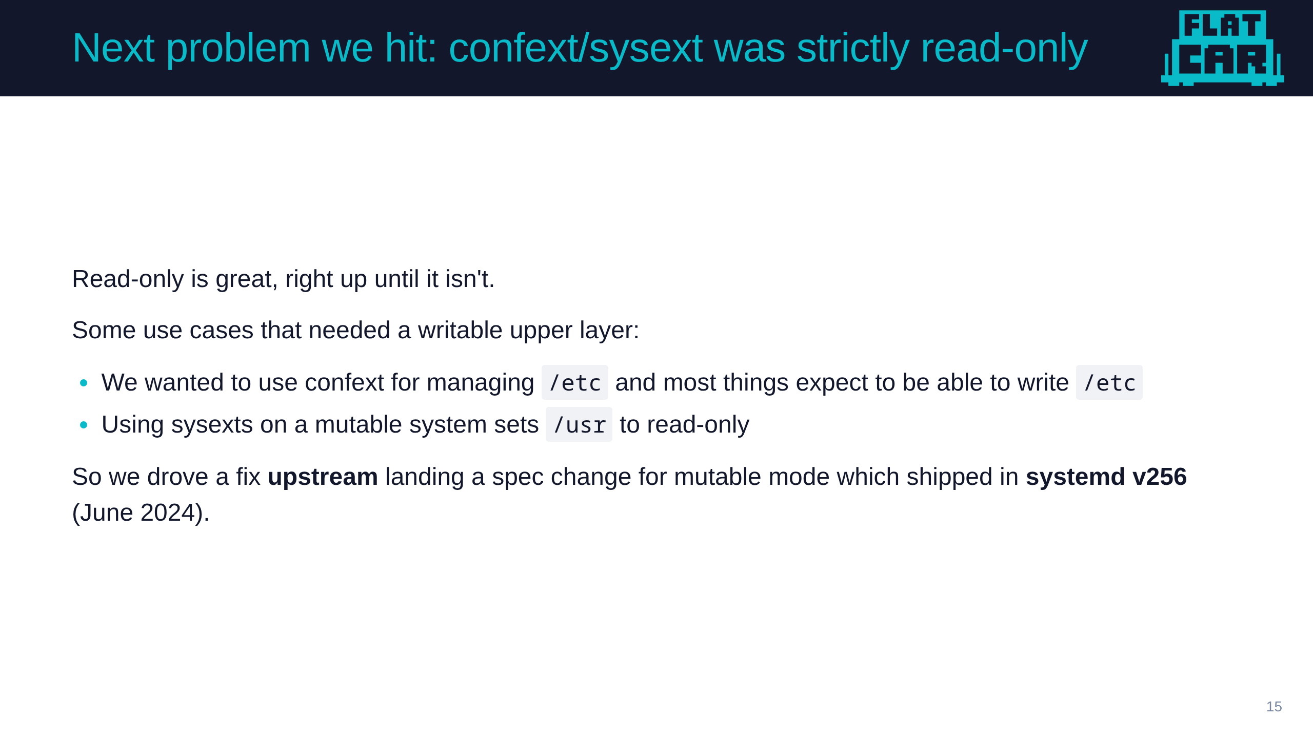
Notes:
Daniel
- Remind what confext is
- The mechanism: systemd-sysext --mutable= modes — disabled, auto, enabled, import, ephemeral, ephemeral-import
- This is the upstream-contribution arc the talk title promises.
- The clever trick: if /var/lib/extensions.mutable/usr is a symlink to /usr, the host /usr becomes the overlay upperdir — writes go straight back to the base. That's how confext works on a mutable /etc.
- The detailed paper trail, if anyone asks: Kai Lüke filed Flatcar issue #986 (Mar 2023); Thilo Fromm wrote UAPI Spec PR #78 (merged May 2024); Krzesimir Nowak wrote systemd PR #31000 (merged Feb 2024). All three are Flatcar maintainers — our colleagues, they deserve the credit.

Slide 16
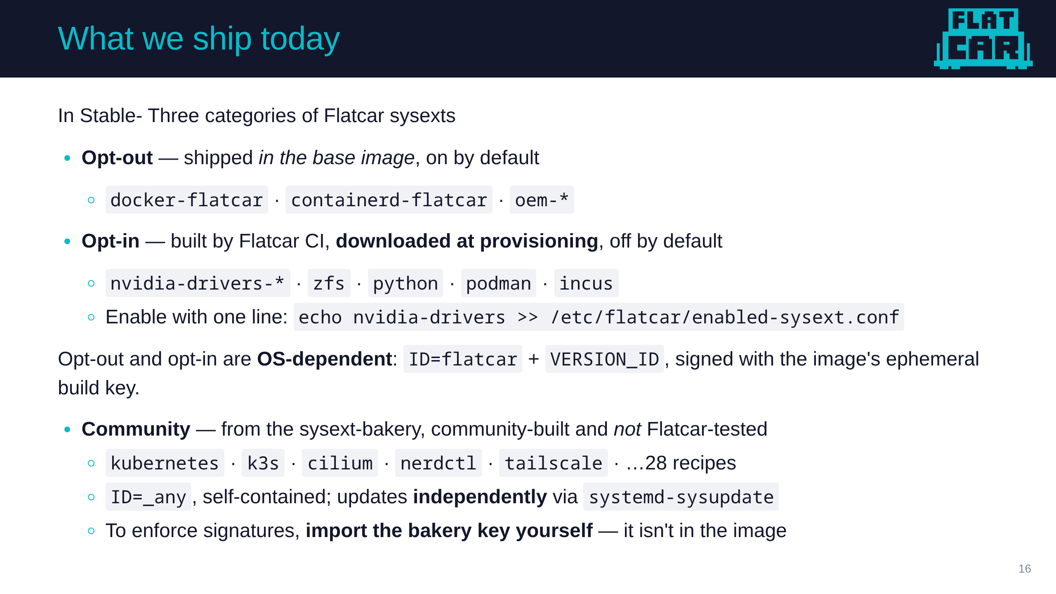
Notes:
bex
- Opt-out ships IN the image. Docker and containerd are not in /usr anymore
- Opt-in is built by our CI and downloaded at provisioning time, not baked into the image.
- You turn it on with one line in enabled-sysext.conf.
- Opt-out + opt-in are both OS-dependent, and both are signed during hte release cycle and the key is created there
- Community is the bakery
— community-built, not release-tested, self-contained. 28 recipes today.

Slide 17
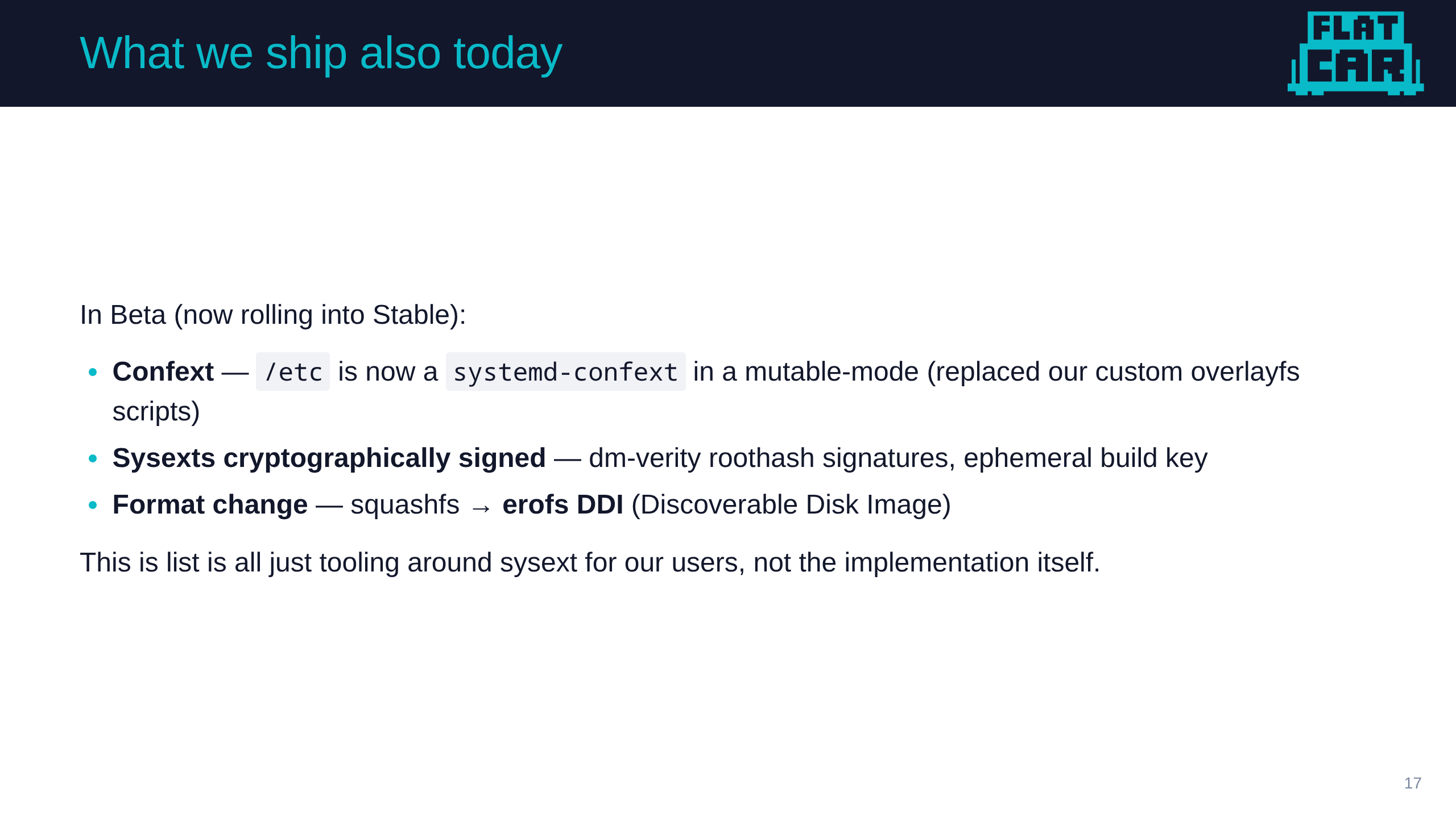
Notes:
bex
- we have got cool stuff coming up through channels and that has already landed in our beta channel.
- I am particularly excited for confext as those of us with long-lived pet-like hosts can have an easier time working with our customizations and playbooks

Slide 18
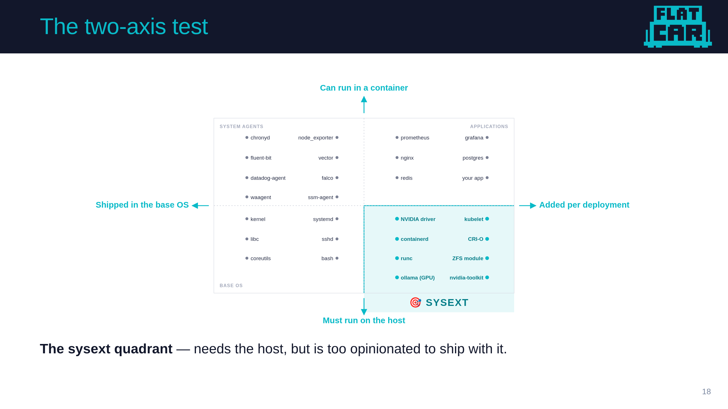
Notes:
bex
- As you think about using system extensions there are two models that are useful
- first, the two axis test
- vertical = "does this need to be on the real host or can it run in a container?"
- Horizontal = "does this ship in the base OS image or get added per deployment?"
- Top-left: SYSTEM AGENTS. Things you may bake into the OS image but could also containerize
- Top-right: APPLICATIONS. Stuff users add like workloads and similar infra apps
- Bottom-left: BASE OS. This is the core of the OS and reflects the distros core opinion
- Bottom-right: SYSEXT. Things you need on the host but which users will have feels about

Slide 19
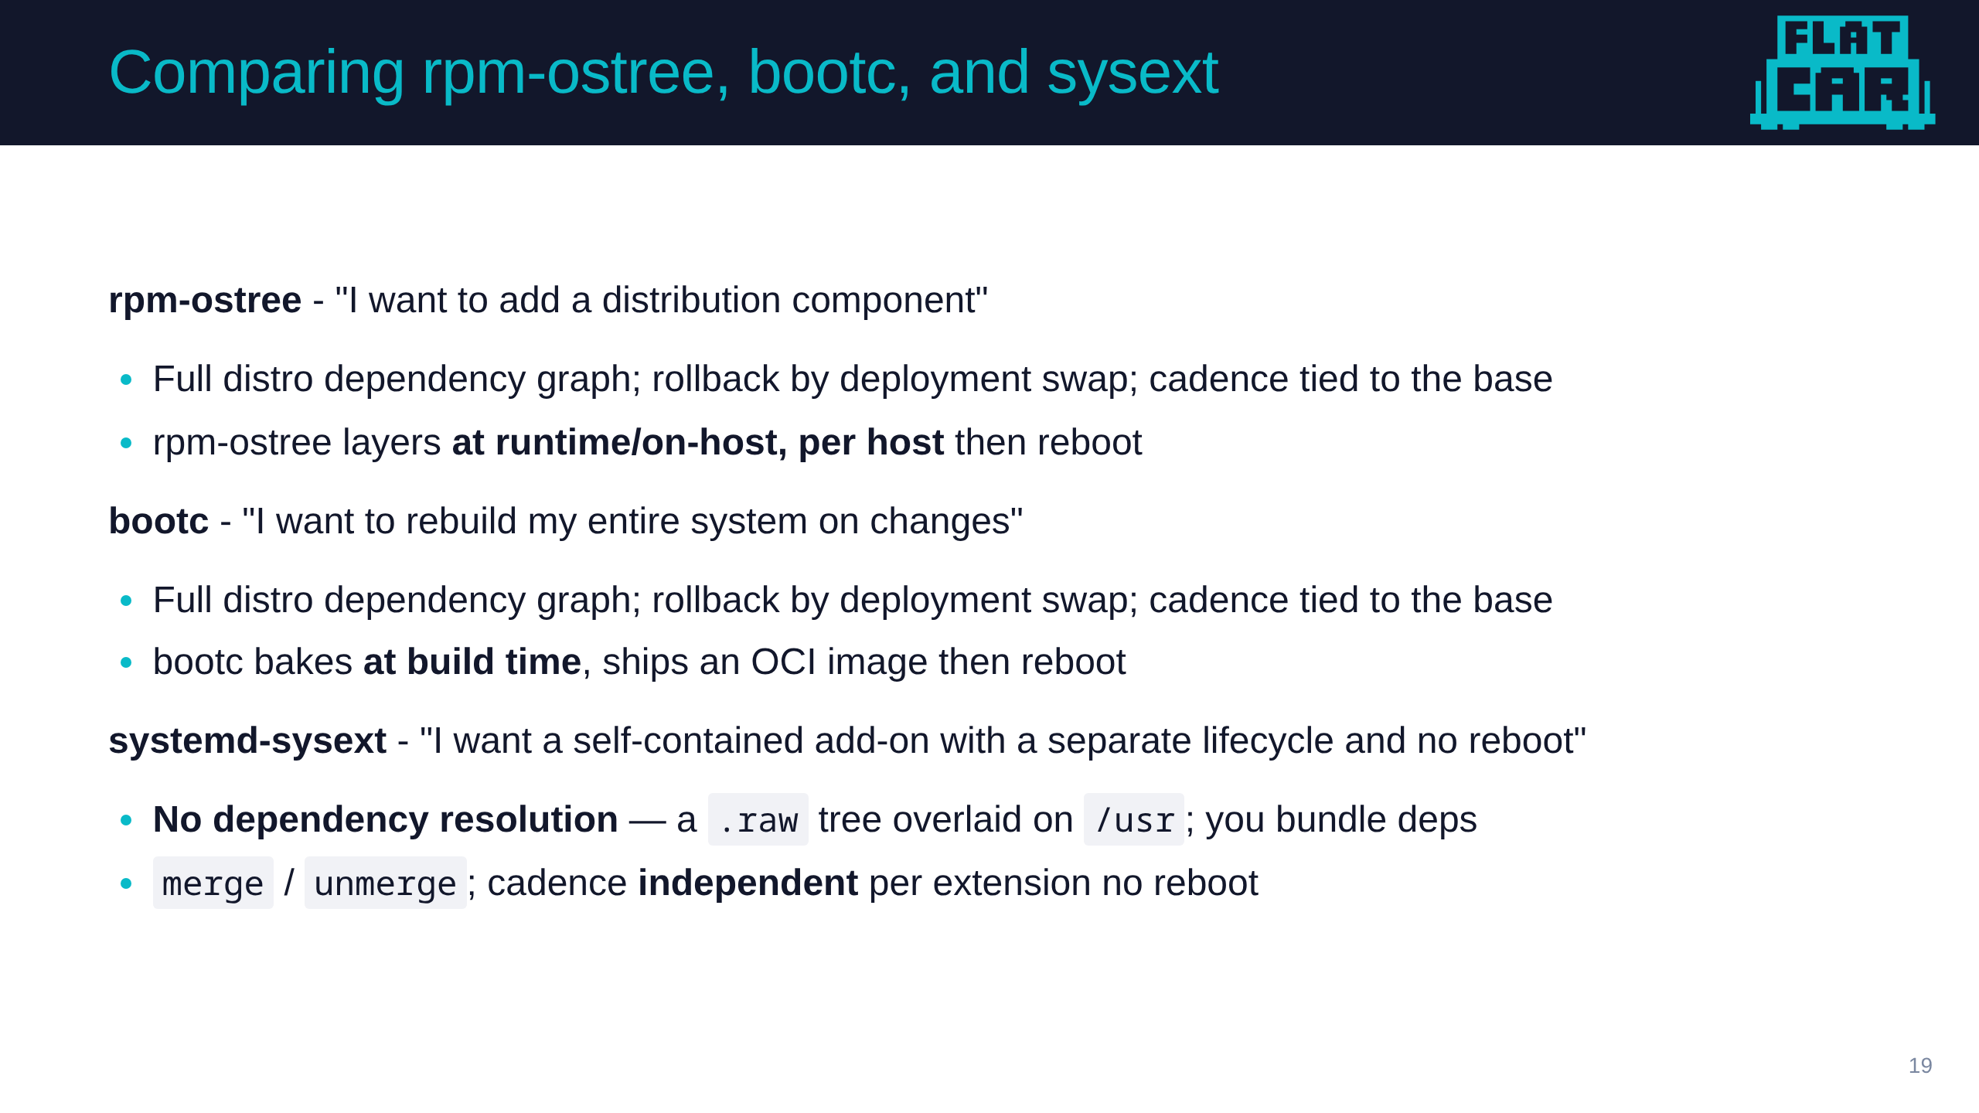
Notes:
bex
- another model close to home is which tech to choose
- These are all great choices depending on your goals and desires
- What do you want made easy and what can be hard
- rpm-ostree gives you the full distro package set and dependency graph
- new stuff, existing image
- bootc bakes your customization into the image at build time
- new stuff new image
- sysext gives you a self-contained add-on with its own update clock.
- new stuff new image, but also new stuff same image - a mix of both

Slide 20

Notes:
bex
- 1. In Headlamp point to worker 2 .. let's look at this one. First cordon ...
- 2. Login and cat /etc/os-release - oh look Fedora CoreOS
- 3. Show that there is a sysext loaded
- 4. show kubelet version, then copy staged flatcar update and restart
- 5. same sysext same effect ... different OS
= 6. Headlamp add workload
- 7. Admit we cheated - we had to turn of selinux ... so that's sad. We are thinking about it
- 8. But wait, what's worker-3 - Cordon
- 9. Also Fedora CoreOS
- 10. Using a Fedora CoreOS custom sysext for kubelet
- 11. Update and restart kubelet
- 12. add workload - show they are all on the same version

Slide 21
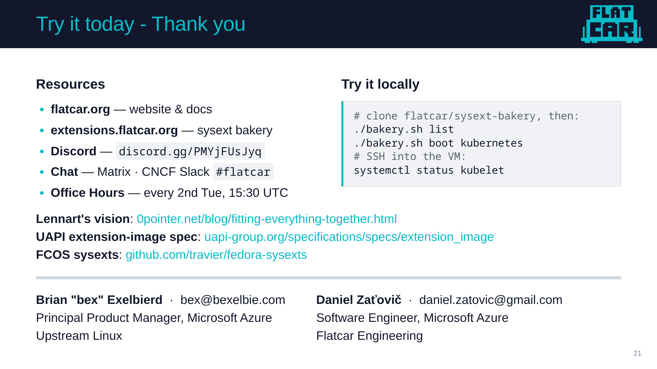

Slide 22

Notes:
- bakery.sh boot is the easiest on-ramp. It spins up a local QEMU VM with a Caddy server in front, Ignition snippet auto-generated, sysext merged.
- Three URLs at the bottom are the canonical reading list — Lennart's vision post, the UAPI spec, and the FCOS community sysexts repo.
- We will hang out in the hallway and at the Flatcar booth.
-- Build Notes:
Build PPTX (with speaker notes, recommended for the actual talk):
make pptx
Build standalone HTML (good for previewing / sharing online):
make html
Build PDF:
make pdf
Live preview while editing (auto-reloads on save):
make serve

